Slide 1
ShanghaiTech University
EE 115B: Digital Circuits
Fall 2024
Lecture 20
Hengzhao Yang
December 26, 2024

Slide 2
Quantizer Terminology
Quantizer size: number of bits used to represent each sample amplitude. With an N-bit quantizer, there are 2^{N} quantization levels
Quantizer resolution (or step size): difference between two adjacent quantization levels
Data rate: how many bits per second (bps) are generated after sampling and quantization?
Data rate=quantizer size * sampling frequency

Slide 3
Example: Audio Compact Disc (CD)
CD quality audio:
  Two 16-bit channels (quantizer size is 16 bits)
  44.1 kHz sampling frequency
  Question: What is the data rate?
  Question: To hold 70 minutes of music, what is the necessary data storage capacity of a CD?
Data rate = 2*(16 b/sample)*(44100 samples/s) = 1411.2*10³ b/s
Storage capacity = (Data rate)*(70*60 s) = 5927*10⁶ b = 706.6 MB

Slide 4
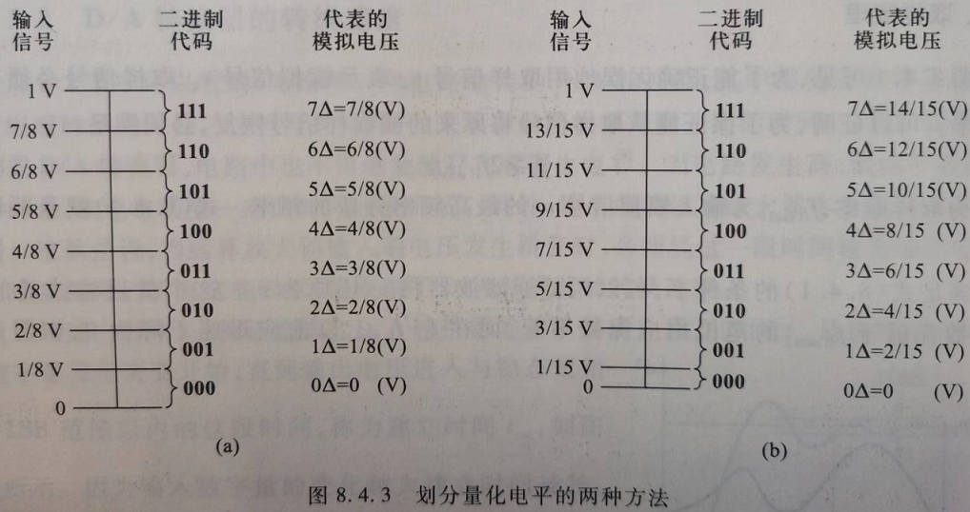
二、量化和编码
量化：将采样电压表示为最小数量单位（Δ：分辨率或步长）的整数倍
编码：将量化的结果用代码表示出来

Slide 5
二、量化和编码
量化误差：当采样电压不能被Δ整除时，将引入量化误差
将0~1 V的模拟电压转换为3位二进制代码，两种方案：
方案a: Δ=1/8 V, 量化等级（列：代表的模拟电压）和参考电平（列：输入信号）均为Δ的整数倍：输入电压为0Δ~1Δ (i.e., 0-1/8 V）均转换为0Δ，对应000（十进制0），, …, 输入电压为nΔ~(n+1)Δ均转换为nΔ，对应十进制n。最大量化误差为Δ。（向下取整）
方案b: Δ=2/15 V, 量化等级（列：代表的模拟电压）为Δ的整数倍，但是参考电平（列：输入信号）不是Δ的整数倍：0Δ~1/2Δ (i.e., 0-1/15 V）均转换为0Δ，对应000（十进制0），1/2Δ~3/2Δ (i.e., 1/15-3/15 V）均转换为1Δ，对应001（十进制1）, …, (n-1/2)Δ~(n+1/2)Δ均转换为nΔ，对应十进制n。最大量化误差为1/2Δ。（中间取整）

Slide 6
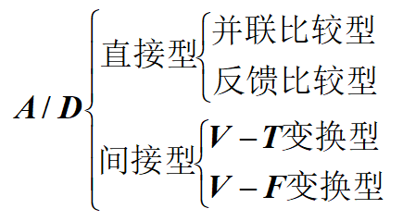
三、ADC分类
并联比较型（闪速：flash）
反馈比较型（逐次逼近型：successive approximation）
V-T: voltage-time（电压-时间变换型或双积分型）
V-F: voltage-frequency（电压-频率变换型）

Slide 7
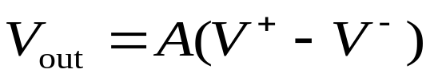

Voltage Comparison: An Open-Loop
Op Amp Functions as a Comparator
V–
–
+
V_{out}
V⁺
V_{out}
In the linear region
V_{sat+}
For a typical op amp,
A is huge (10⁵ or larger)
In saturation
V_{sat-}
V_{sat+} if V⁺ > V⁻
V_{sat-} if V⁺ < V⁻
(V_{sat+} and V_{sat-} are largely determined by power supplies.)
V_{out} =
→ essentially digital output because the linear region is tiny

Slide 8
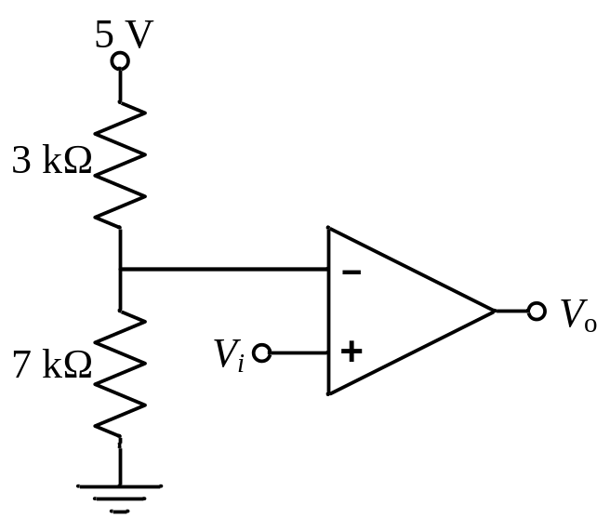
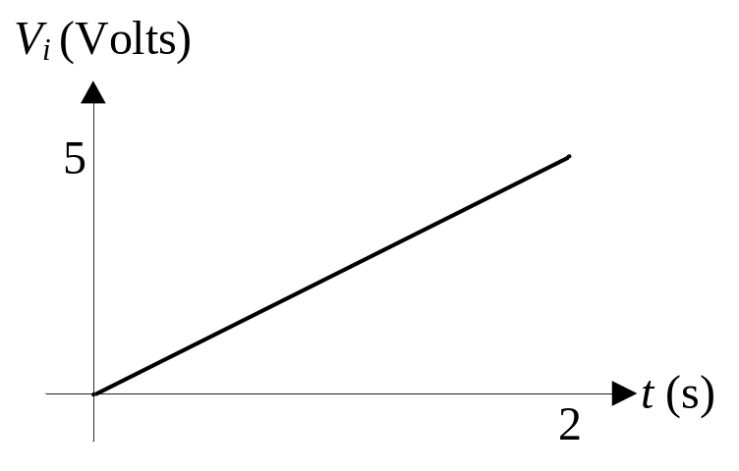
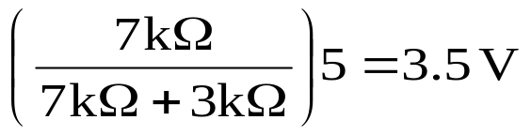

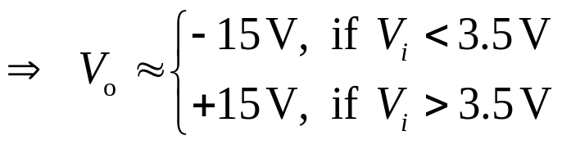
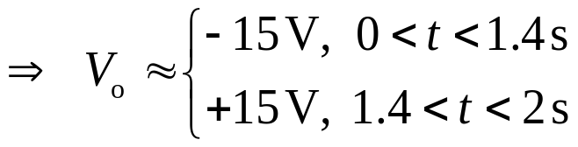
Example: Using an Op Amp as a Comparator
In the circuit below, the analog voltage V_{i} varies linearly from 0 V to 5 V. Graph the output, V_{o}, from t = 0 to t = 2 s. Assume the positive and negative saturation voltages of the op amp are +15 V and -15 V, respectively.
Solution

Slide 9
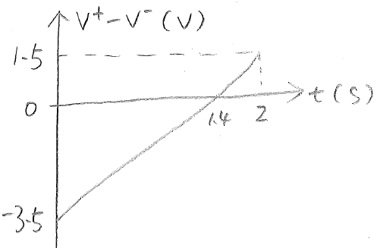
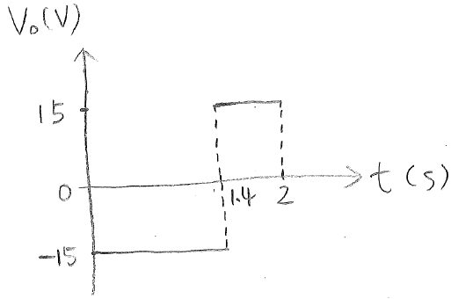
Example: Op Amp as 1-bit ADC
Input: V⁺-V⁻, analog
Output: +15 V or -15 V, digital

Slide 10
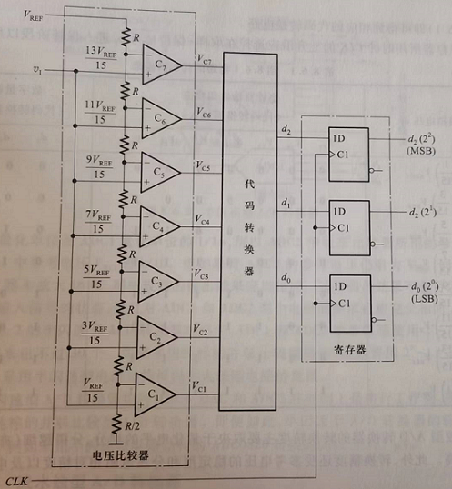
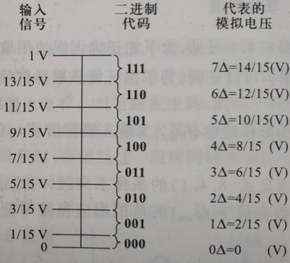
3-bit Flash ADC
Input: 0~V_{REF}
Output: binary code d₂d₁d₀
Threshold voltages

Slide 11
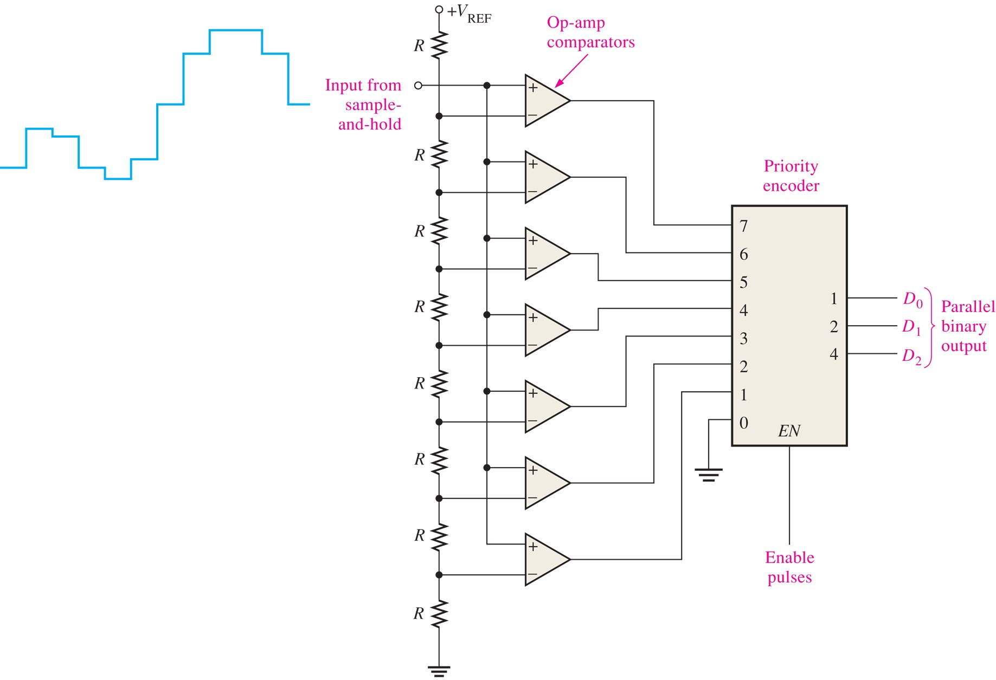
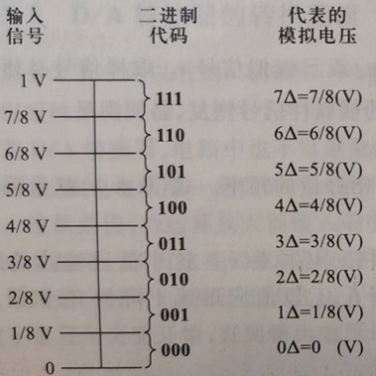
FIGURE 12-12 A 3-bit flash ADC. Different threshold voltages.

Slide 12
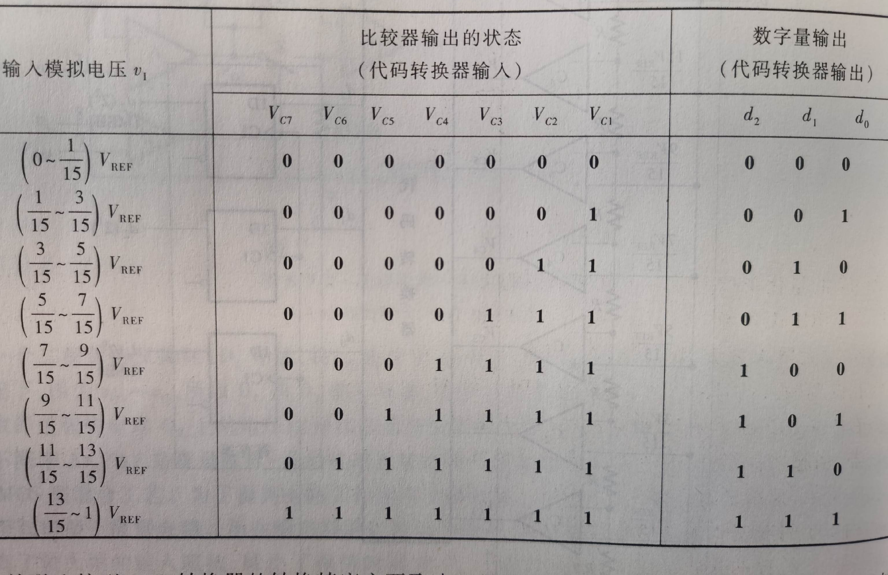
Comparator Outputs

Slide 13
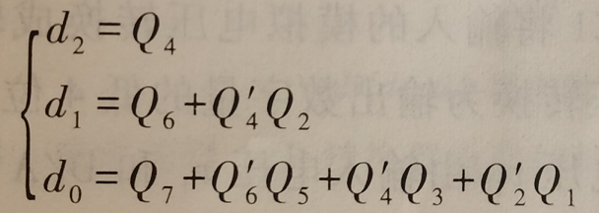
Priority Encoder
Convert comparator outputs to binary codes using a priority encoder

Slide 14
四、Flash ADC特点
1. 速度：快，CLK触发信号到达到输出稳定建立只需几十纳秒
2. 精度：受量化电平精度、参考电压稳定度、分压电阻相对精度等因素影响
3. 电路规模：输出为n位时需要2^{n}-1电压比较器和较大的代码转换电路，常用于8位以下

Slide 15
Digital to Analog Conversion

Slide 16
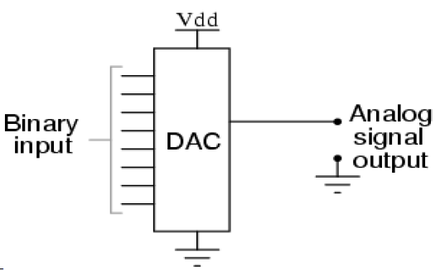
Digital to Analog Conversion
A DAC converts a digital sequence (i.e., a sequence of binary words) into an analog voltage. Ideally, for a given binary input word, the DAC output voltage is proportional to the input word value:
V_{out} = c × (input_word_value)
where c is a constant.

Slide 17
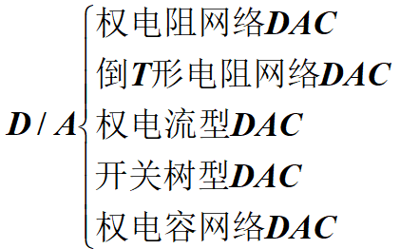
DAC Types
Binary-weighted-input DAC (or R-2^{n}R DAC)：权电阻网络DAC

Slide 18
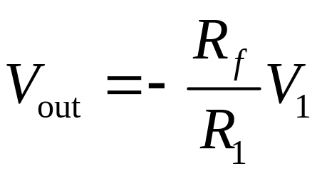
Binary-Weighted-Input DAC
Binary-weighted-input DAC is based on inverting amplifier
Inverting amplifier
R_{f}
R₁
V₁
–
+
V_{out}

Slide 19
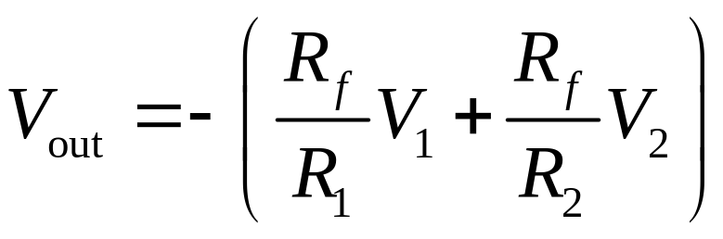
DAC Building Block: Summing Amplifier
R_{f}
R₁
V₁
–
+
V_{out}
V₂
R₂

Slide 20
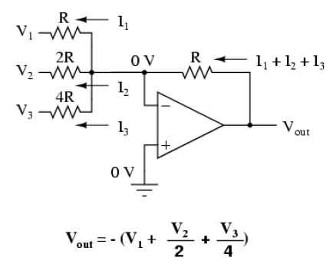
From Summing Amplifier to DAC
Different input resistance for different input

Slide 21
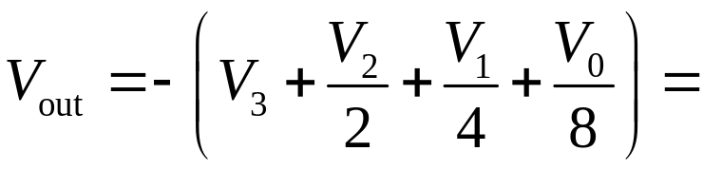
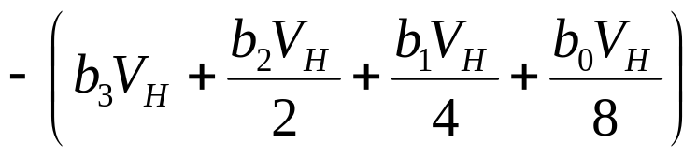
4-bit Binary-Weighted-Input DAC
R
MSB
V₃
R
Binary input: b₃b₂b₁b₀
2R
Assume
V₂
V_{H}, if b_{i}=1
0, if b_{i}=0
–
+
V_{i} =
4R
V₁
V_{out}
8R
Equivalently,
V_{i} = b_{i}V_{H}
LSB
V₀
Goal: Verify that this is a DAC (verify that V_{out} is proportional to input word value).
=-V_{H}/8(2³b₃+2²b₂+2¹b₁+2⁰b₀)
=constant*(decimal value of binary input)

Slide 22
Review
Chapter 1: Introduction
  Basic concepts

Slide 23
Chapter 2: Numbers and codes
Numbers
  Decimal
  Binary
  Hexadecimal
  Octal
Codes
  BCD, Gray, and ASCII
  Parity check

Slide 24
Chapter 3: Logic gates
Circuit symbol, operation, truth table, and logic expression
  NOT
  AND
  OR
  NAND
  NOR
  XOR
  XNOR

Slide 25
Chapter 4: Boolean algebra and logic simplification
Basic Boolean algebra relationships
DeMorgan’s theorem
SOP and POS expressions: standard and minimum, explicit and concise
Karnaugh map: minimum SOP and POS expressions, with and without don’t cares
Quine-McCluskey method

Slide 26
Chapter 5: Combinational logic analysis
Logic forms: AND-OR, AND-OR-Invert (AOI), NAND, and NOR
Combinational logic design flow

Slide 27
Chapter 6: Combinational logic blocks
Adder
Encoder
Decoder
Comparator
MUX
DEMUX

Slide 28
VHDL
Basic structures: entity and architecture
Behavioral and structural coding
Combinational and sequential logic

Slide 29
Chapter 7: Basic sequential circuits
Blocks: circuit symbol, operation, and characteristic table
  Latches
  Flip-flops
Modules
  Registers
  Counters

Slide 30
Chapter 8: Synchronous sequential circuits
Design flow
  Moore FSMs
  Mealy FSMs

Slide 31
Chapter 9: Data Conversion
Sampling
Quantization
Analog to digital conversion (ADC)
  Flash ADC
Digital to analog conversion (DAC)
  Binary-weighted-input DAC

